Slide 1
Server-side Development with NodeJS, Express and MongoDB

Slide 2
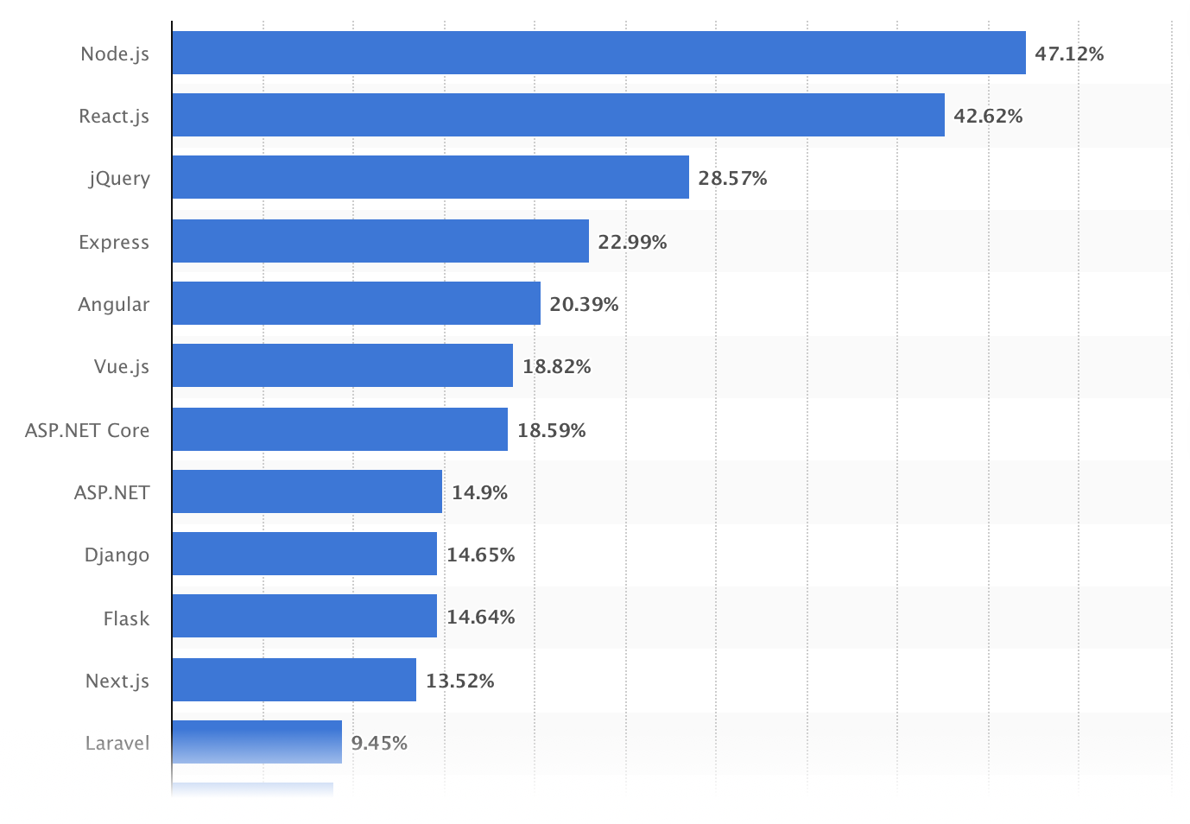
Why should you study this course?
Source: LinkedIn (Data Collected: April 23, 2021)
Most used web frameworks among developers worldwide, as of 2022
Source: https://www.statista.com/statistics/1124699/worldwide-developer-survey-most-used-frameworks-web/

Slide 3
Prerequisites
Completed:
DBI202; FER201m

Slide 4
Course Objectives
Demonstrate an understanding of server-side concepts, CRUD, and REST
Build and configure a backend server using the NodeJS framework
Build a RESTful API for the front-end to access backend services

Slide 5
Course Description
Overview of Web protocols: HTTP and HTTPS.
Introduction of NodeJS and NodeJS: Express modules to build a web server.
Deploy the application on a web server with basic CRUD operations. Work with NoSQL databases, specifically MongoDB and Mongoose, to access MongoDB from NodeJS.
Overview of REST and building a RESTful API.
Learn Authentication and security-related issues for web applications.

Slide 6
Course Plan
See course plan on FLM
(https://flm.fpt.edu.vn)

Slide 7
Materials/ References
https://www.coursera.org/learn/server-side-nodejs
Pro MERN Stack - Full Stack Web App Development with Mongo, Express, React, and Node
React Quickly_ Painless Web Apps with React, JSX, Redux and GraphQL
CMS forum

Slide 8
Learning Environments
NVM (Node Version Management) - v0.39.1
NodeJS - v19.3.0
NPM (Node Package Management) - v9.2.0
Express - v4.18.1
Postman
MongoDB (Community) - v6.0
Visual Studio Code (version 1.59 or later) (https://code.visualstudio.com/Download)
A Notebook for reports of labs and assignments.

Slide 9
Course Rules
How to conduct
Prepare contents of the next session at home
Following lessons in classroom
Completing module assessments in time and Quizzes (via CMS)
Write reports of all labs and assignments to your notebook
Communication
Class
Interchange by FU-HN CMS, Forum
Discussing actively in your team and classroom
Free to question and answer
Others
Off phone, no game, no chat in class
Use laptop under teacher’s instruction

Slide 10
Evaluation Strategy
Must attend more than 80% of contact hours (if not, not allow to take exam).
Evaluating
03 Progress Test (PT: 15%)
04 Assignment (AS: 15%)
01 Project (PR: 20%)
01 Practical Exam (PE: 20%)
Final Exam (FE: 30%)
Final result = 15%(PT) + 15%(AS) + 20%(PR) + 20%(PE) + 30% (FE)
Pass:
Every on-going assessment component > 0
Final Exam score >= 4
Final result >= 5
Final exam retake only when not passed

Slide 11
How to study
This course is complex knowledge (however, it’s attractive and exciting), so you need to keep a tight grip on it
Read
On the books to get the general concept
Reference, study, collection from anywhere else (internet, your classmate, forum …)
Attend lectures
Listen, understand, then make your notes
Give your explanation about some topic in lectures
Ask questions
Give some examples that do not exist in your book
Practice all the exercises, demo to make your sense
After classes
Discuss your classmate indirectly, on the forum
Analyze, design, and implement labs and assignment. Write reports in your notebook
Build your team in yourselves to support together in studying

Slide 12
Academic policy
Cheating, plagiarism and breach of copyright are serious offenses under this Policy.
Cheating
Cheating during a test or exam is construed as talking, peeking at another student’s paper or any other clandestine method of transmitting information.
Plagiarism
Plagiarism is using the work of others without citing it; that is, holding the work of others out as your own work.
Breach of Copyright
If you photocopy a textbook without the copyright holder's permission, you violate copyright law.

Slide 13
Install tools for programming if needed
Q&A

